Slide 1

Spark Streaming Concepts

Slide 2
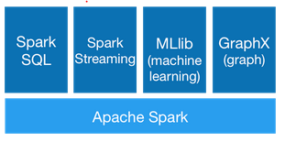
What is Spark ?
A fast and general engine for large-scale data processing
Alternative to Map Reduce
Spark modules

Slide 3
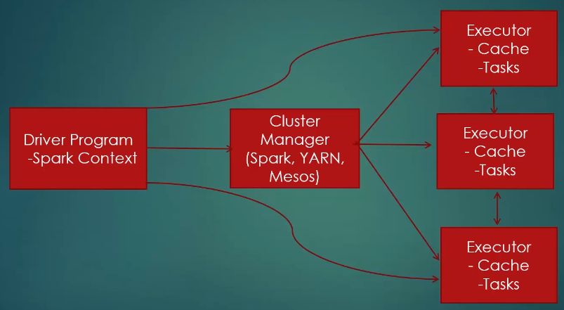
Spark execution process

Slide 4
Spark
Horizontally scalling architecture
100x fast than Hadoop MapReduce, 10x faster on disk
DAG engine that optimizes workflows
Used at Amazon, Ebay, NASA, TripAdvisor, Yahoo etc.
Code can be done on Python, Java, Scala
Build around RDD (Resilient Distributed Dataset)

Slide 5
RDDs
Resilient to failures (e.g one cluster node goes down)
Distributed – on a cluster
Dataset – data that we’re doing to work on

Slide 6
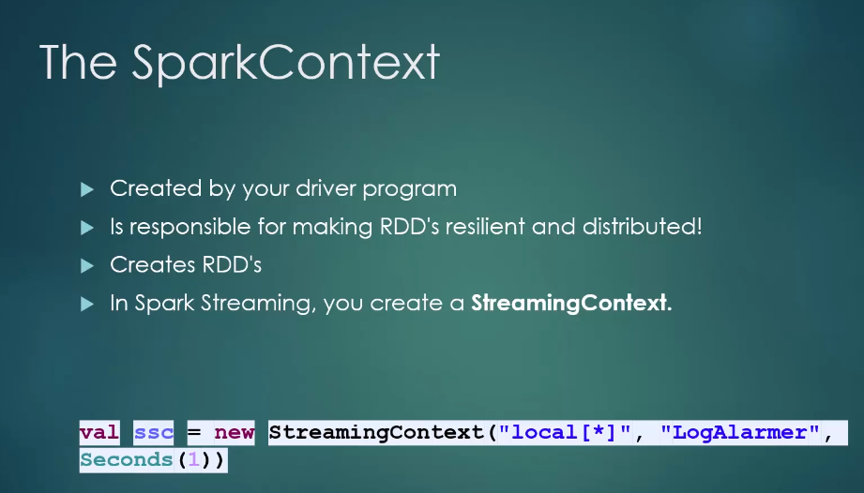
SparkContext

Slide 7
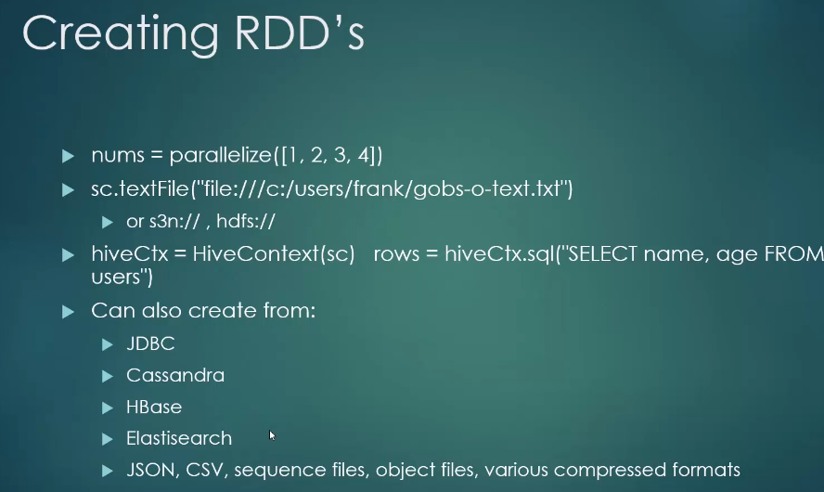
RDDs

Slide 8
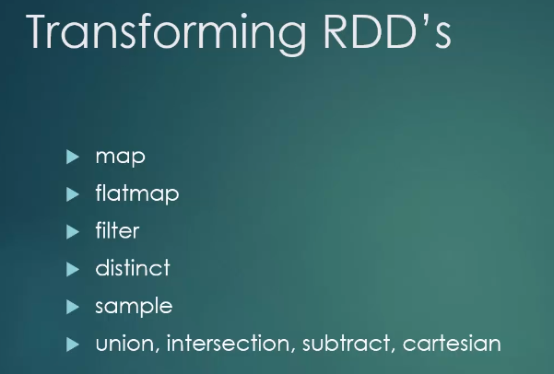
RDDs

Slide 9
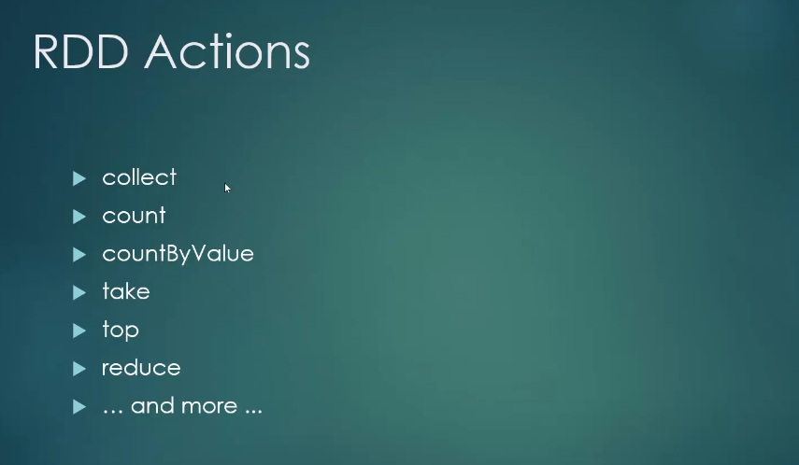
RDDs

Slide 10
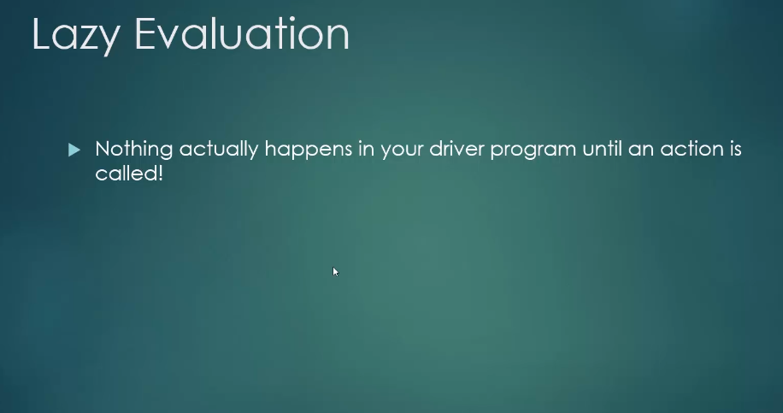
RDDs

Slide 11
RDDs
Hands on coding
Count the words in a file
Steps
Import the project in Intelijj
Setup external JARS (spark + twitter): File -> Project Structure -> Libraries
Make sure you have Scala 11 SDK and not newer!!! (File -> Project Structure -> Platform Settings -> Global Libraries)

Slide 12
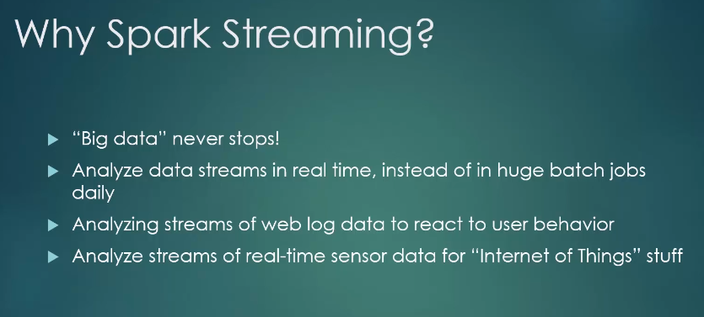
Spark Streaming

Slide 13
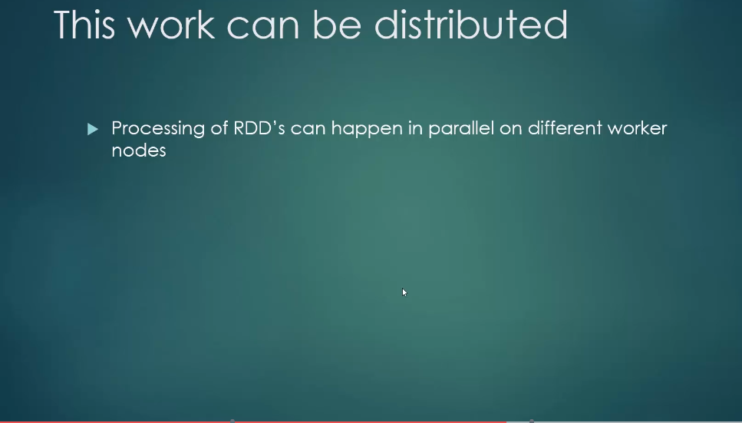
Spark Streaming

Slide 14
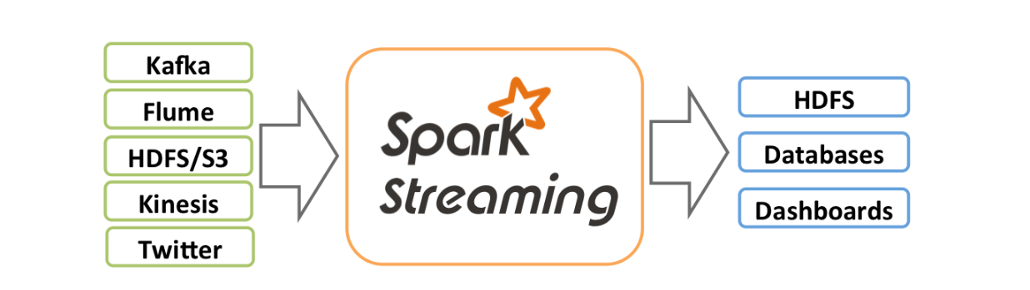
Spark Streaming

Slide 16
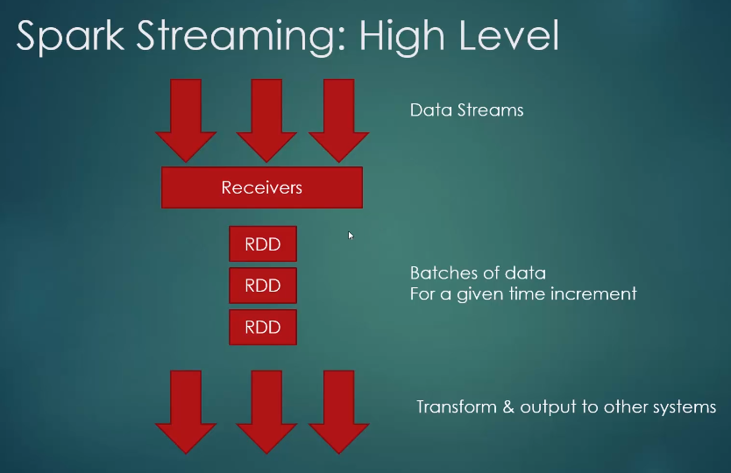
Spark Streaming

Slide 17
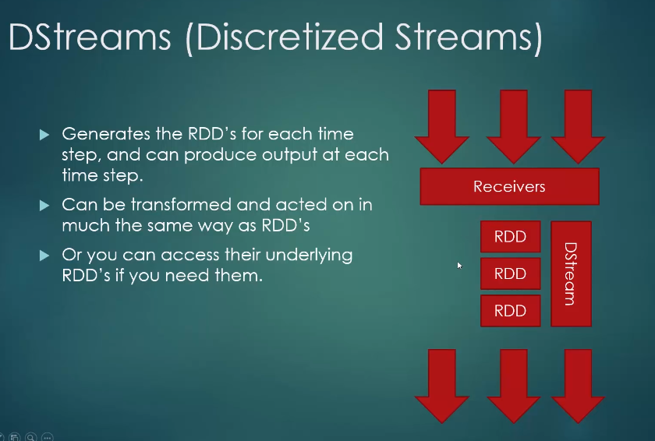
Spark Streaming

Slide 18
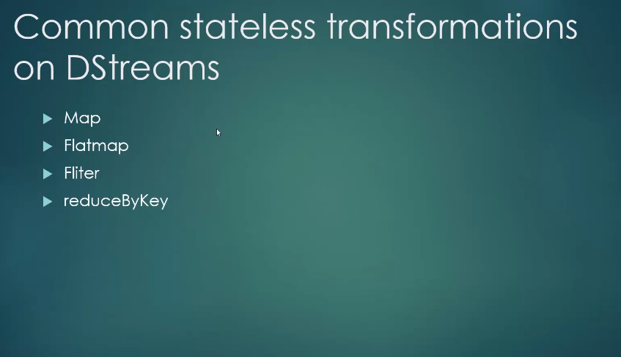
Spark Streaming

Slide 19
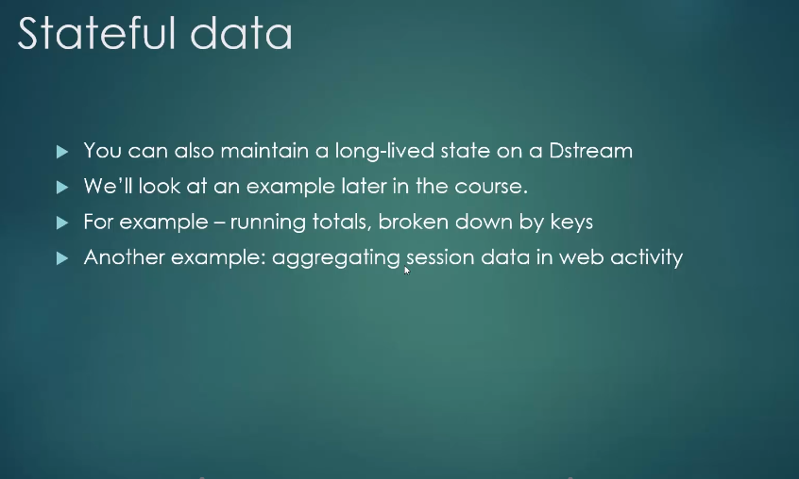
Spark Streaming

Slide 20
Hands on coding
Setup your own credentials in twitter.txt
Go to code:
PrintTweets.scala
Exercise: Display languages and hashtags (one per line) for each tweet.

Slide 21
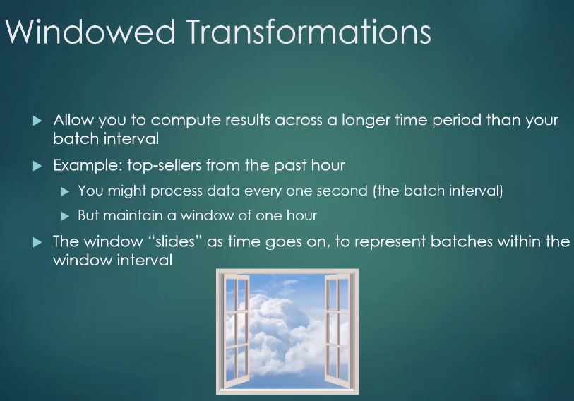
Windowing

Slide 22
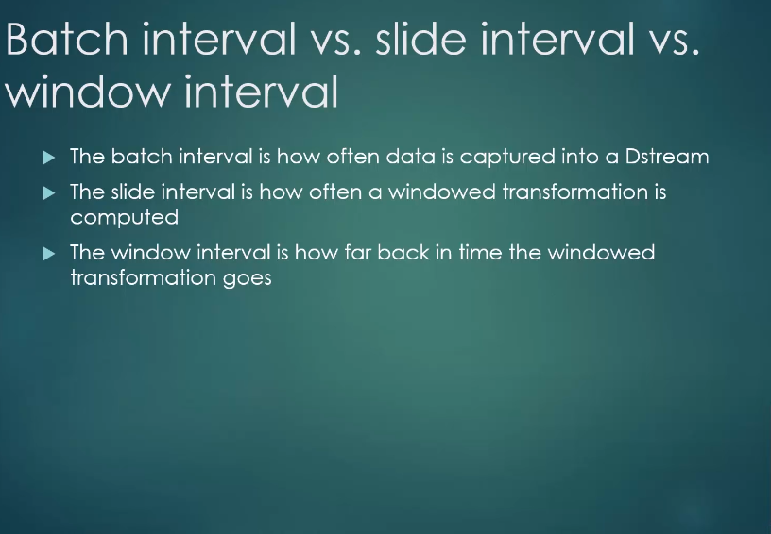
Windowing

Slide 23
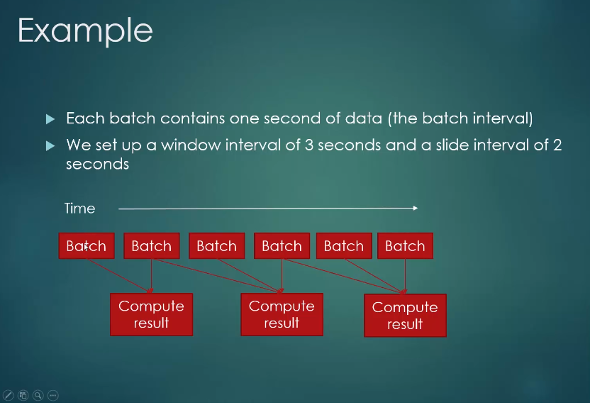
Windowing

Slide 24
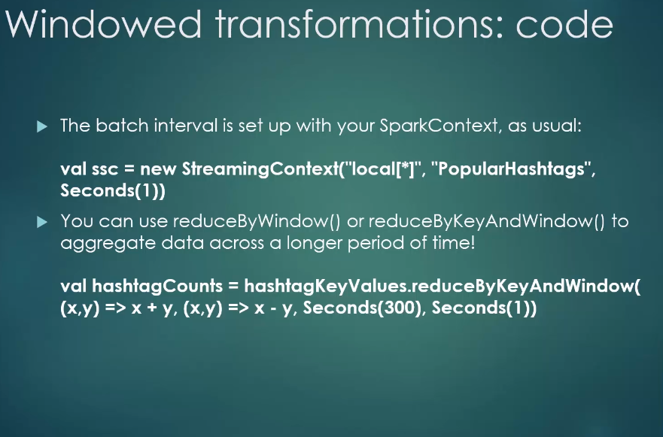
Windowing

Slide 25
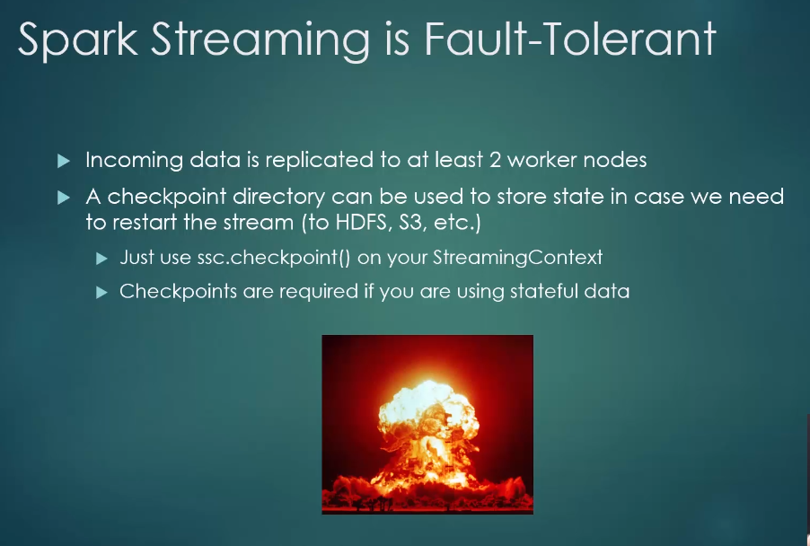
Fault tolerance

Slide 26
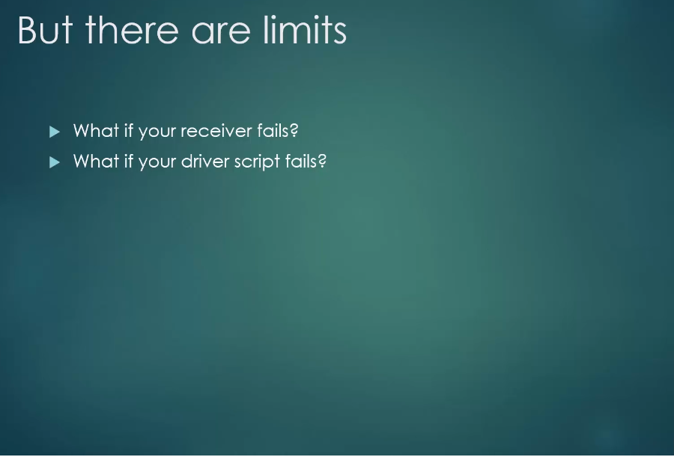
Fault tolerance

Slide 27
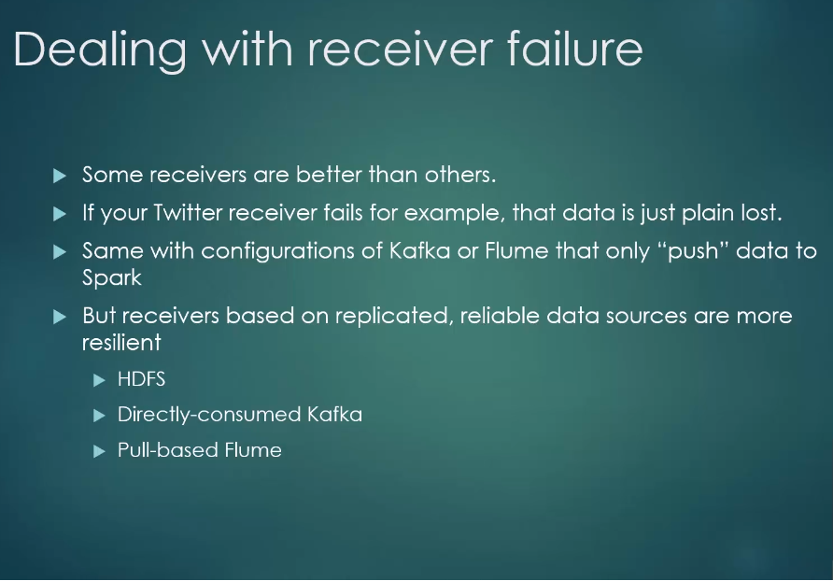
Fault tolerance

Slide 28
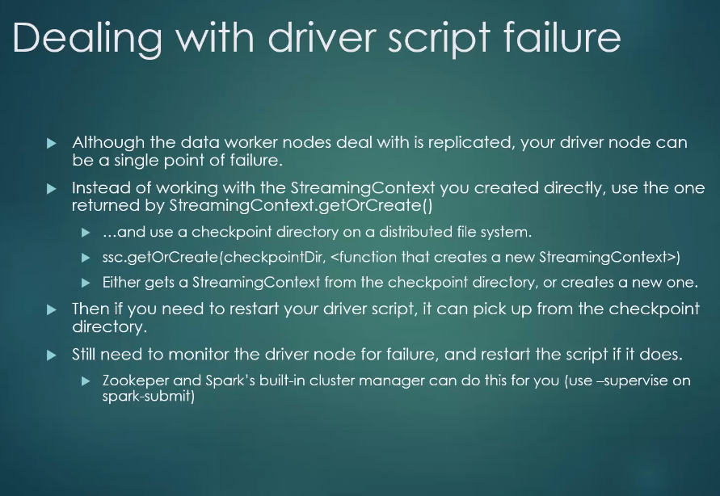
Fault tolerance

Slide 29
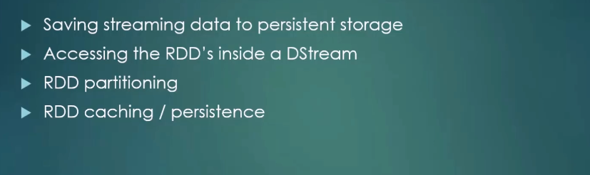
Exercise
Exercise
Save Tweets to Disk

Slide 30
Exercise
Exercise
Tracking the Average Tweet Length
Tracking the Max Tweet Length

Slide 31
Exercise
Exercise
Tracking the most popular hashtags
Tracking the most popular word

